Slide 1
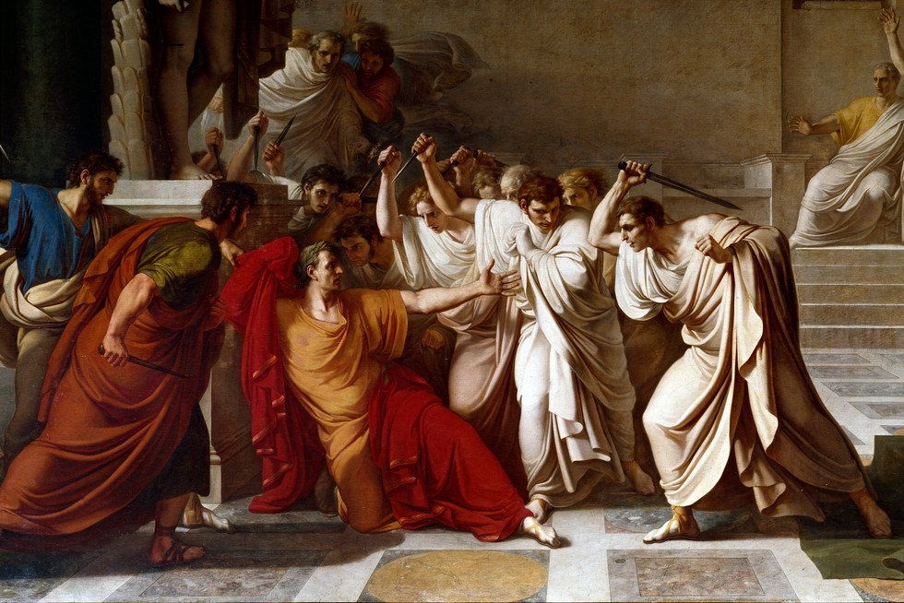
The Conflict of the Orders
GOAL/S: Describe the key causes of the Conflict of the Orders
Week 3, Lesson 2

Slide 2
Discussion Questions
Have you ever felt that certain groups in society have more power than others?
What impacts does this have today?

Slide 3
Analyse the following
https://www.worldhistory.org/uploads/images/17368.png?v=1701240183

Slide 4
The "Conflict of the Orders" refers to the historical struggle and tension between these two social classes as the plebeians sought to gain more political and legal rights, challenging the dominance of the patricians. The resolution of this conflict over time led to the creation of a more inclusive political system within the Roman Republic. In the context of the "Conflict of the Orders" in ancient Rome, the term "orders" refers to the two distinct social classes or groups within Roman society.
Notes:
Emphasize difference in power dynamics and authority
Different privileges, status

Slide 5
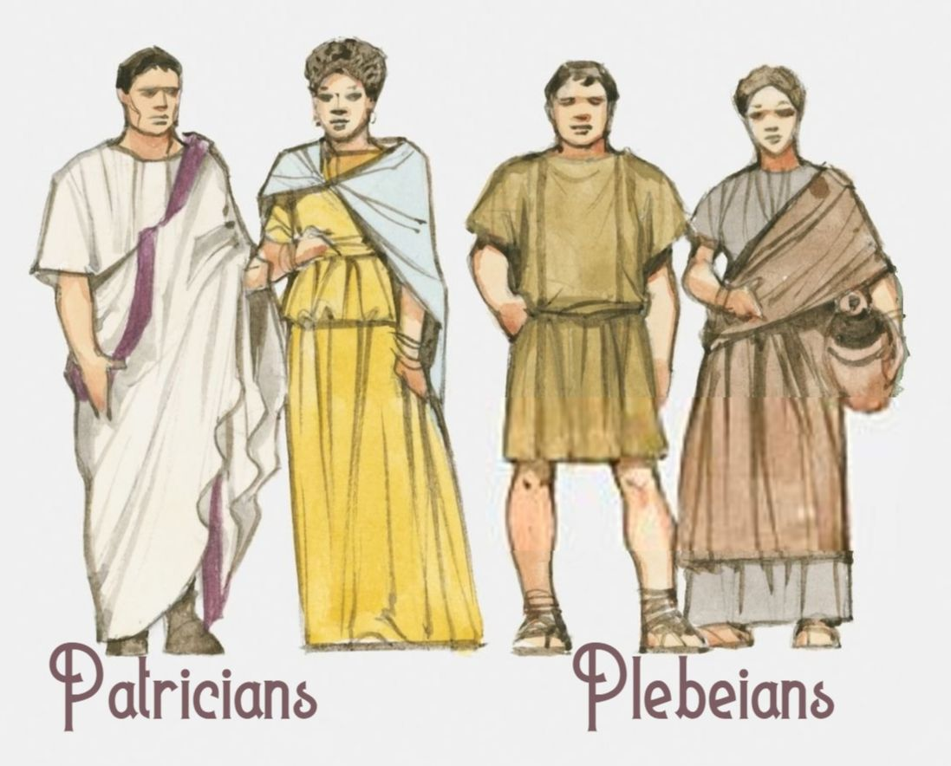
Patrician
DEFINITION:
wealthy upper social class
small group of privileged elite who came from old aristocratic families
held most of the political power
controlled important offices and were often involved in decision-making processes within the Roman Republic.
(Aristocratic - the highest class in certain societies, typically comprising people of noble birth holding hereditary titles and offices)

Slide 6
Plebeians
DEFINITION:
The ‘common people’
lower social class; the majority of Rome’s population
farmers, merchants, and other non-aristocratic citizens
initially had limited political rights and faced economic challenges
sought greater representation and protection from the patrician class
SYNONYMS: proletariat, working class, lower ranks
Notes:
Highlight Struggles here

Slide 7
Watch the following:
https://www.youtube.com/watch?v=EKCAlkffecM&ab_channel=MagistraVitae
Does anything seem familiar here?

Slide 8
ACTIVITY – Key People, Events, Ideas
Organise a FULL PAGE into three categories – key people, key events, key ideas
I will share information about the ‘Conflict of the Orders’ historical context (P / E / I)
You will summarize this information into your book

Slide 9
Key People
Conflict of the orders – historical context

Slide 10
Gaius Marcius Coriolanus (c. 5th century BCE)
KEY PEOPLE
A Roman patrician general known for his conflicts with the plebeians. His story highlights tensions between the classes.

Slide 11
Lucius Sextius Lateranus (circa 4th century BCE)
KEY PEOPLE
One of the first plebeians to become consul after the passage of the Licinian-Sextian Laws in 367 BCE

Slide 12
Tribunes of the Plebs
KEY PEOPLE
Elected officials representing the plebeians and tasked with protecting their interests. They played a crucial role in the Conflict of the Orders.

Slide 13
Key Events
Conflict of the orders – historical context

Slide 14
Key Events
The First Secession (494 BCE):
Plebeians withdrew from Rome in protest against harsh patrician policies. This event marked the beginning of the plebeian struggle for greater rights.
The Twelve Tables (451–450 BCE):
The creation of the Twelve Tables, Rome's first written laws. This was a response to the plebeians' demand for transparency and protection against arbitrary legal decisions.
The Licinian-Sextian Laws (367 BCE):
A series of laws that addressed plebeian demands, including the establishment of the consulship as a shared office between patricians and plebeians.
The Conflict of the Orders Resolved (287 BCE):
The passage of the Lex Hortensia, which granted laws passed by the Plebeian Council (concilium plebis) the same legal standing as laws passed by the Roman Senate (patrician-dominated).

Slide 15
Key Ideas
Conflict of the orders – historical context

Slide 16
Key Ideas
Plebeian Struggle for Equality:
The overarching theme of the Conflict of the Orders is the plebeians' pursuit of greater political representation and protection against patrician oppression.
Legal Reforms:
The establishment of written laws (Twelve Tables) and subsequent legal reforms aimed to address the plebeians' grievances and create a more transparent legal system.
Institutional Changes:
The inclusion of plebeians in political offices, particularly the consulship, marked a significant shift in Roman governance, signaling a move toward a more inclusive system.
Role of Tribunes:
The creation of the Tribune of the Plebs provided a formal mechanism for plebeian representation and protection, allowing them to veto actions of magistrates and propose laws on behalf of the plebeians.

Slide 17
Watch the following
https://www.youtube.com/watch?v=NxW_X4kzeus&ab_channel=LionsgateMovies
Notes:
"The Hunger Games: The Ballad of Songbirds and Snakes" is a prequel to Suzanne Collins' original "Hunger Games" trilogy and provides insights into the early years of the Hunger Games in the fictional world of Panem. While it is not a direct retelling of the Conflict of the Orders in ancient Rome, there are thematic connections that can be drawn, particularly in terms of social inequality and the struggle for power.
1. Social Inequality:
In "The Ballad of Songbirds and Snakes," the Capitol maintains control over the districts through a stark social hierarchy. The districts, with their varying degrees of poverty and oppression, can be likened to the social divisions between patricians and plebeians in ancient Rome.
2. Tribute System and Exploitation:
The tribute system in the Hunger Games, where children from the districts are chosen to participate in a deadly competition for the Capitol's entertainment, reflects a form of exploitation similar to the struggles faced by plebeians in ancient Rome. The tributes, like the plebeians, are subjected to the whims and desires of the ruling class.
3. Efforts for Change:
The protagonist, Coriolanus Snow, grapples with his own ambitions and the desire for societal change. His character arc may draw parallels with historical figures in Rome who sought to navigate the complexities of the political landscape and address issues of inequality.
4. Consequences of Power Dynamics:
The novel explores the consequences of power dynamics and the lengths to which individuals may go to maintain or challenge the existing social order. This theme aligns with the power struggles between patricians and plebeians in ancient Rome.

Slide 18
ACTIVITY – Historical Context
Description | Marks
Accurately identifies and discusses the historical context of Source 1, demonstrating a sound historical knowledge of the period. The answer includes discussion of: relevant event/s and/or significant person/people and/or key idea/s | 4
Identifies and briefly discusses the historical context of Source 1, demonstrating some historical knowledge of the period, but with omissions. The answer includes discussion of: relevant event/s and/or significant person/people and/or key idea/s | 3
Identifies and provides a simple description the historical context of Source 1, demonstrating a limited historical knowledge of the period. The answer includes discussion of: relevant event/s and/or significant person/people and/or key idea/s | 2
The answer demonstrates little historical knowledge of the period, with very simple description of: One (or two) of the criteria mentioned above, or The answer is factually inaccurate, or The answer simply describes the source | 1
We will analyse TWO (2) sample paragraphs that answer a Source Analysis question – ‘Historical Context’ – about the ‘Conflict of the Orders’.
Share your feedback, before writing your own.

Slide 19
SAMPLE A – Historical Context
Long time ago, Rome had a big fight called the Conflict of the Orders. It happened in the old Roman Republic, around 5th and 4th centuries BCE. There were two groups - rich ones called patricians and regular folks called plebeians. The regular folks were sad because they didn't have much say in the government, and the rich ones made all the rules. The regular folks, called plebeians, wanted better rights and protection. They did some things like a big protest in 494 BCE, and then they got a guy called Tribune of the Plebs to help them. This fight changed Rome a lot and made new rules that helped regular folks. The Conflict of the Orders was an important time for Rome.

Slide 20
SAMPLE B – Historical Context
The Conflict of the Orders, a pivotal episode in Roman history, unfolded during the early years of the Roman Republic, primarily in the 5th and 4th centuries BCE. The historical context of this conflict is rooted in the social and political structure of ancient Rome. At the time, Roman society was divided into two main classes: the patricians, comprising the privileged aristocracy, and the plebeians, the common citizens facing economic hardships. This division led to a power struggle between the classes, as the plebeians sought increased political representation and protection from the arbitrary decisions of the patrician magistrates. Key events, such as the First Secession of the Plebs in 494 BCE and the subsequent establishment of the office of the Tribune of the Plebs, reflect the tension and the plebeians' efforts to secure their rights. The Conflict of the Orders marked a transformative period in Roman history, shaping the development of political institutions and setting the stage for legal reforms that addressed the grievances of the common people. This historical context underscores the significance of the Conflict of the Orders as a crucial chapter in the evolution of the Roman Republic.

Slide 21
INSTRUCTIONS:
Description | Marks
Accurately identifies and discusses the historical context of Source 1, demonstrating a sound historical knowledge of the period. The answer includes discussion of: relevant event/s and/or significant person/people and/or key idea/s | 4
Identifies and briefly discusses the historical context of Source 1, demonstrating some historical knowledge of the period, but with omissions. The answer includes discussion of: relevant event/s and/or significant person/people and/or key idea/s | 3
Identifies and provides a simple description the historical context of Source 1, demonstrating a limited historical knowledge of the period. The answer includes discussion of: relevant event/s and/or significant person/people and/or key idea/s | 2
The answer demonstrates little historical knowledge of the period, with very simple description of: One (or two) of the criteria mentioned above, or The answer is factually inaccurate, or The answer simply describes the source | 1
Write your own HISTORICAL CONTEXT paragraph.
It must be marked and edited by ONE (1) other student.
You must show me when it has been written, edited, and marked.

